Slide 1
SIVA – Video Portal
Web Engineering Project
UWE-Modelling
SoSe 2010
Johannes Toball
Florian Kaspar

Slide 2
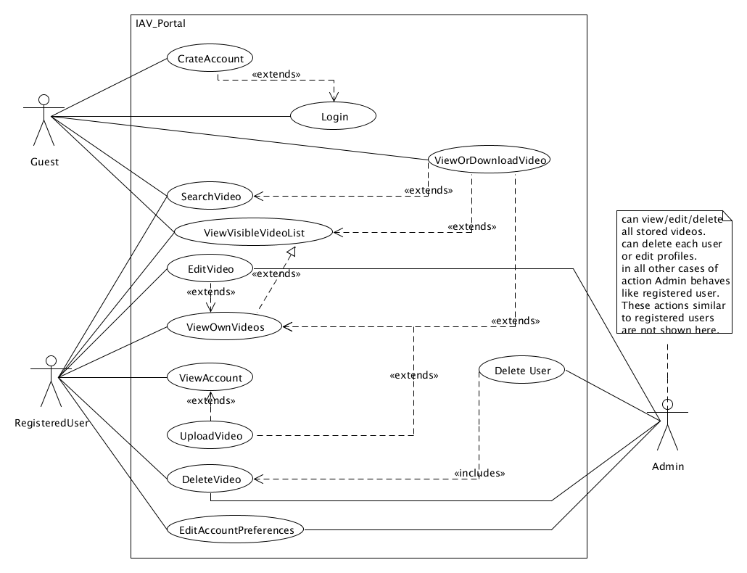
UseCase-Diagram
SoSe 2010
Johannes Toball
Florian Kaspar

Slide 3
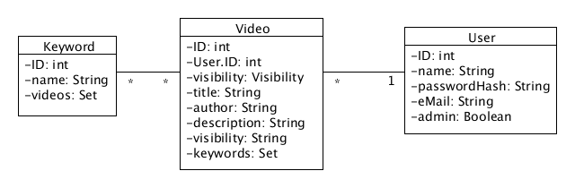
Content-Model
Objects temporally stored in Java Beans
Use database for persistent storage
SoSe 2010
Johannes Toball
Florian Kaspar

Slide 4
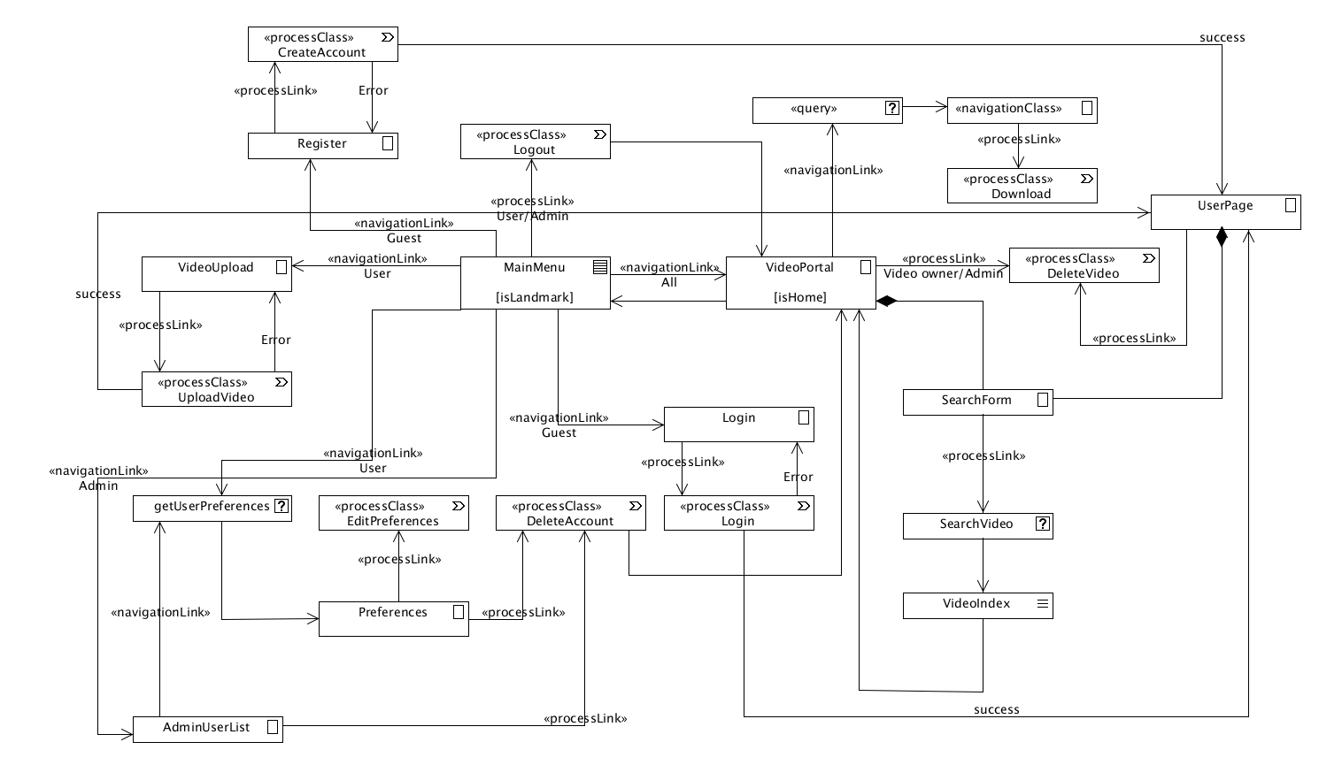
Navigation-Model
SoSe 2010
Johannes Toball
Florian Kaspar

Slide 5
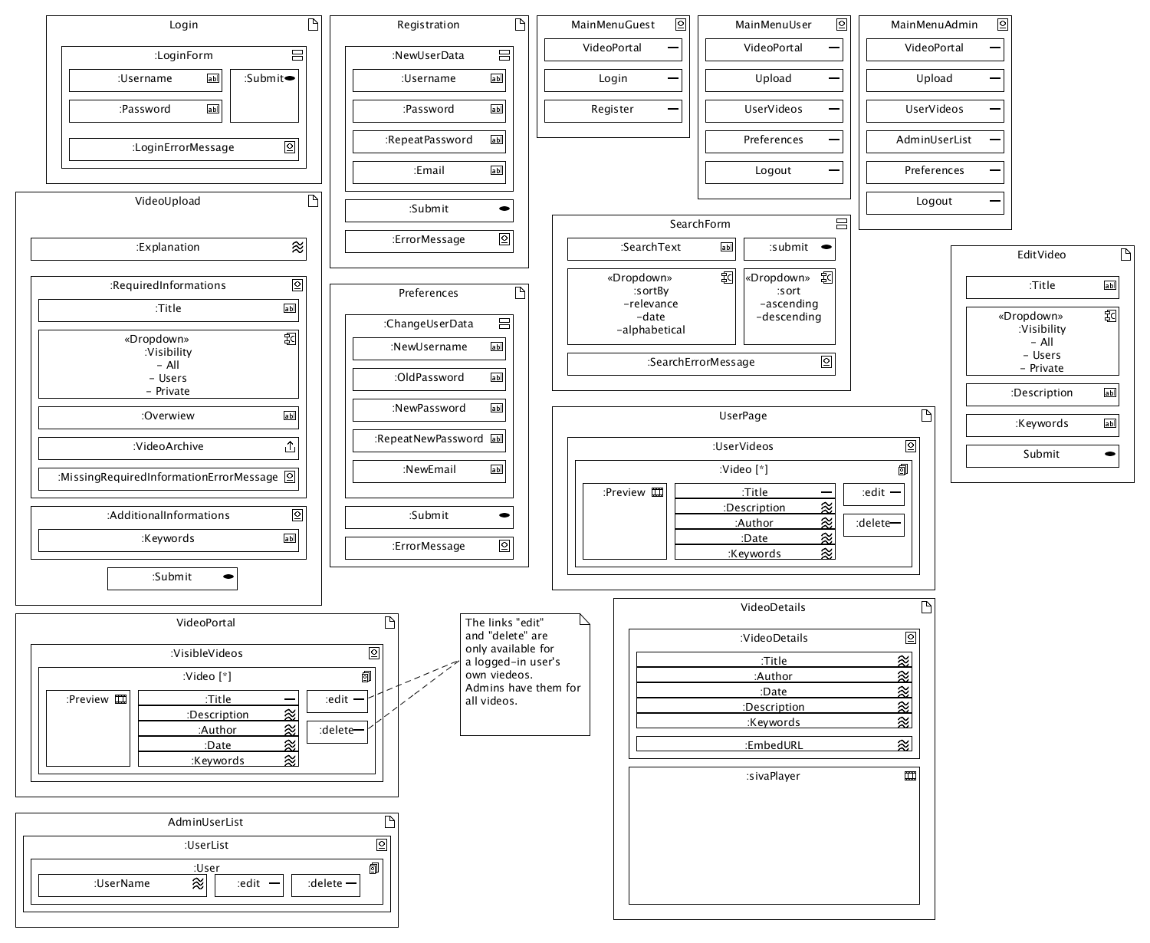
Presentation-Model
SoSe 2010
Johannes Toball
Florian Kaspar

Slide 6
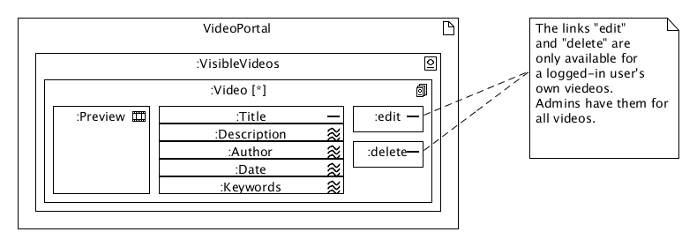
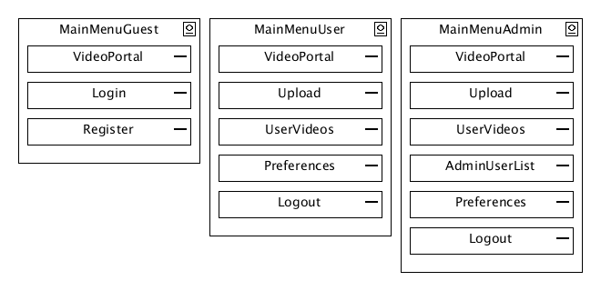
Presentation-Model: VideoPortal, MainMenu
Different appearence for User, Guest and Admin
VideoPortal also used for displaying UserPage
SoSe 2010
Johannes Toball
Florian Kaspar

Slide 7
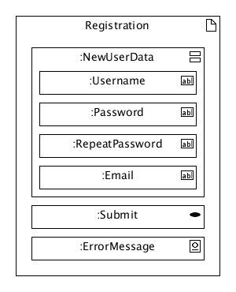
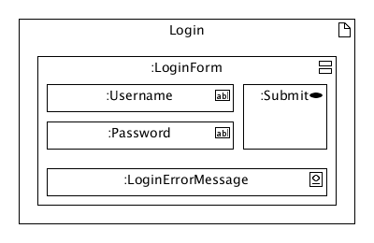
Presentation-Model: Login, Registration
SoSe 2010
Johannes Toball
Florian Kaspar

Slide 8
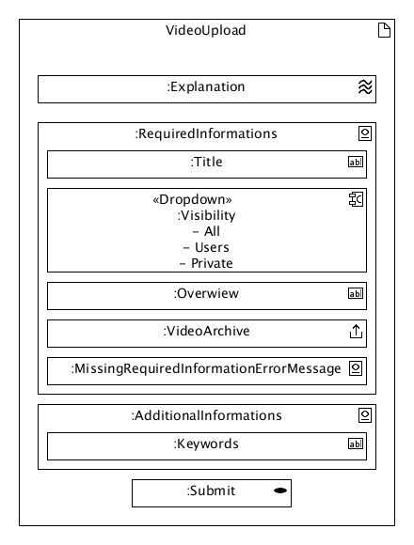
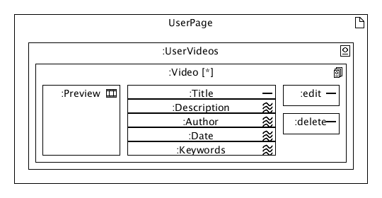
Presentation-Model: UserPage, VideoUpload
SoSe 2010
Johannes Toball
Florian Kaspar

Slide 9
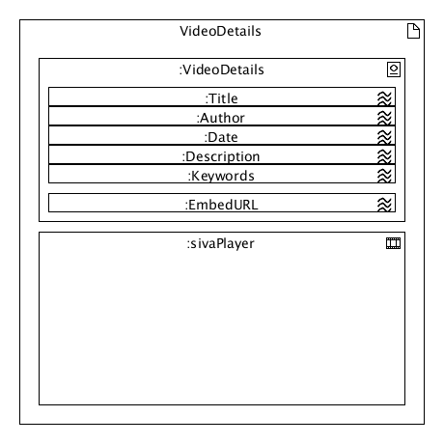
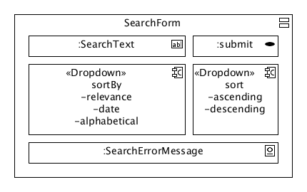
Presentation-Model: SearchForm, VideoDetails
SoSe 2010
Johannes Toball
Florian Kaspar

Slide 10
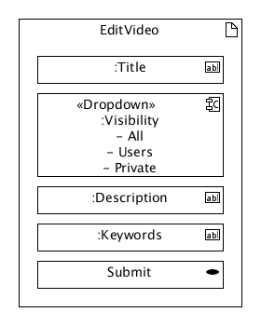
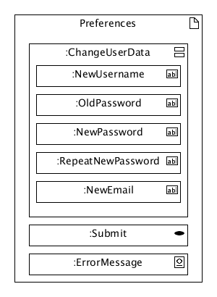
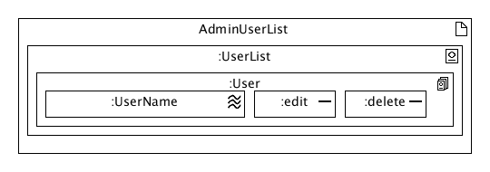
Presentation-Model: EditVideo, Preferences, AdminUserList
SoSe 2010
Johannes Toball
Florian Kaspar

Slide 11
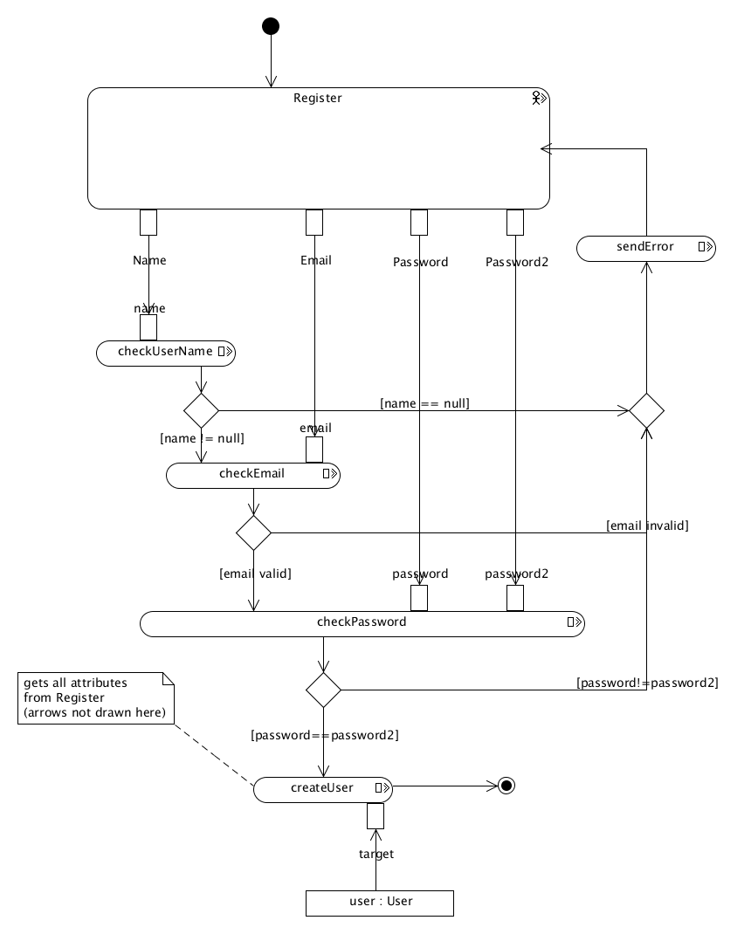
Process-Model: Register
Check username
Check email-address
Check if password was re-typed correctly
On success: Create a new User object
SoSe 2010
Johannes Toball
Florian Kaspar

Slide 12
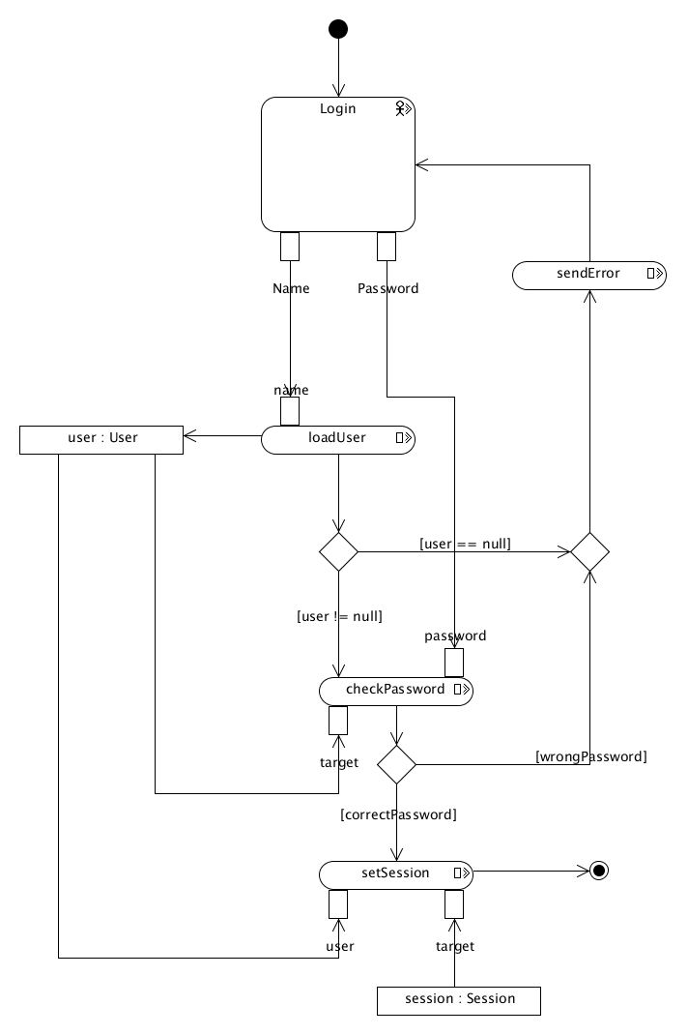
Process-Model: Login
Get user by username
Compare typed-in password with stored password
On success: create new session for User
SoSe 2010
Johannes Toball
Florian Kaspar

Slide 13
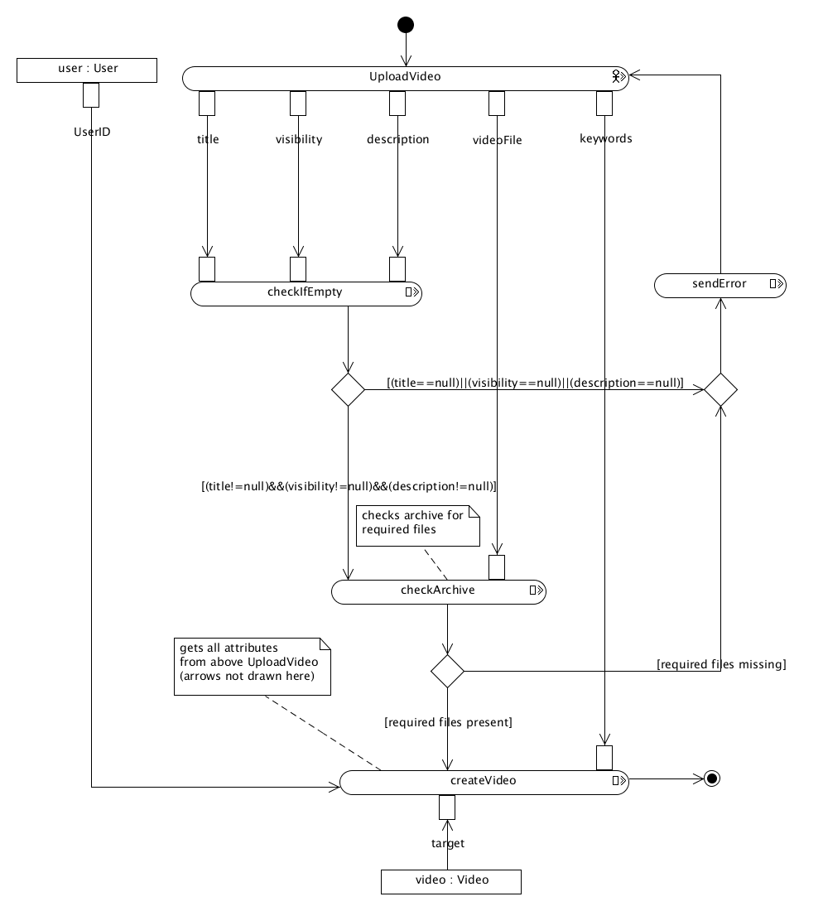
Process-Model: VideoUpload
Check if required fields contain information
Check video-archive for required files
On success: create new Video object (plus Keyword object if keywords given – not included in graphics)
SoSe 2010
Johannes Toball
Florian Kaspar

Slide 14
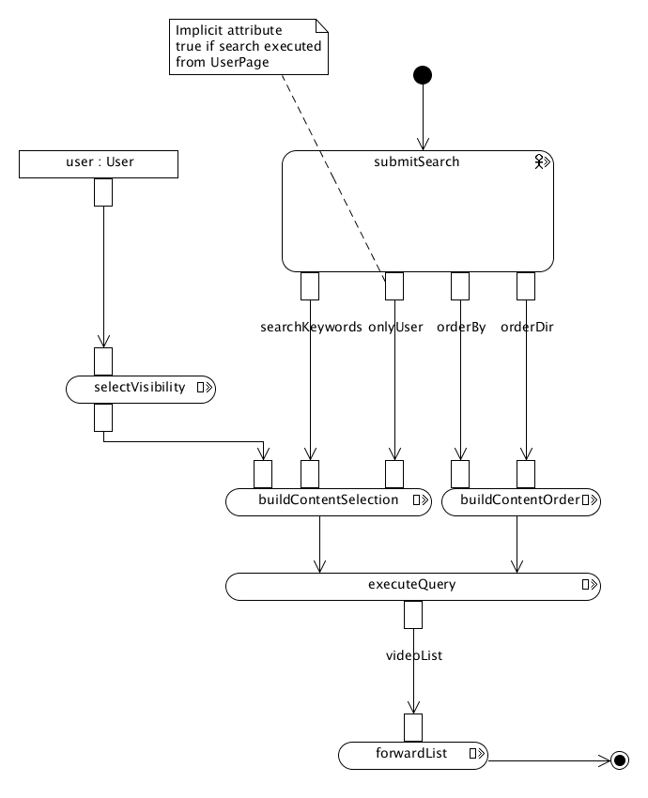
Process-Model: Search
Build Query-String from user input
Include User object (if any) for applying visibility settings
Execute query and forward its results
SoSe 2010
Johannes Toball
Florian Kaspar

Slide 15
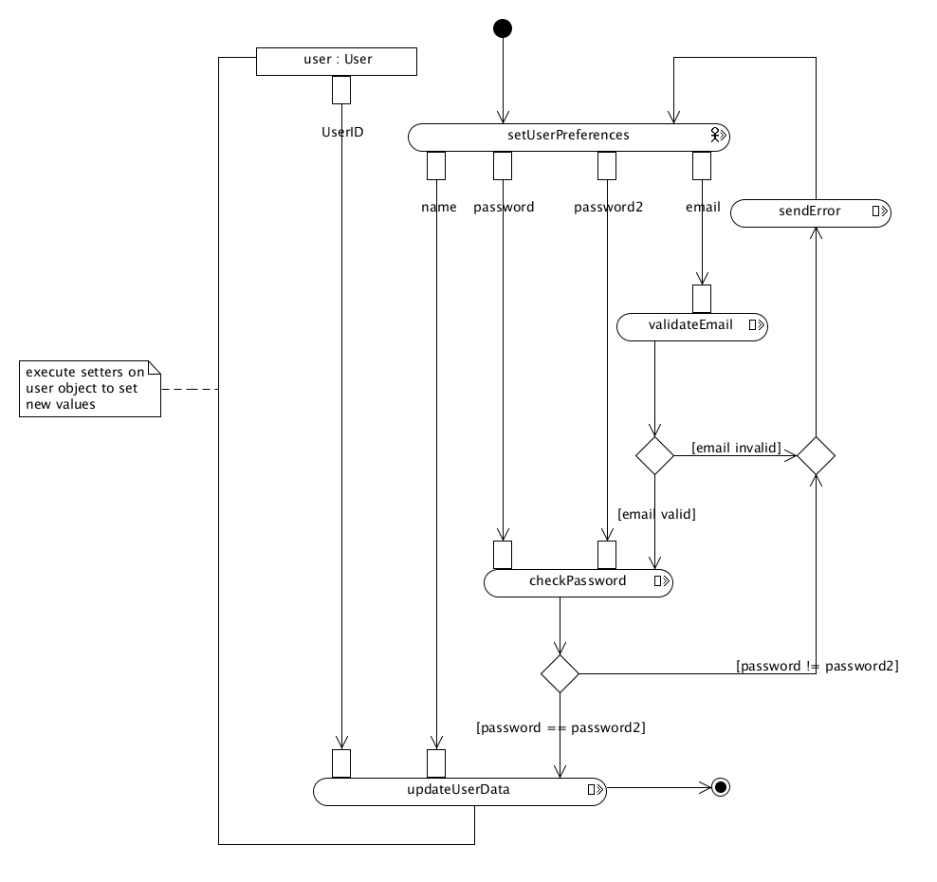
Process-Model: Preferences
Check for valid Email
Check for correctly re-typed new password
On success: change User object‘s attributes
SoSe 2010
Johannes Toball
Florian Kaspar

Slide 16
Implementation: Technologies
Tomcat 6 as container
Struts 2.1.8.1 as framework
Tiles 2.0.6 as templating engine
Hibernate 3.5.3 as ORM-mapper
MySQL 5 as database for persistent data
JavaMail for sending mails, one mail to be precise
SoSe 2010
Johannes Toball
Florian Kaspar

Slide 17
Implementation: Structure
Model: Beans for Users, Videos and Keywords
One-to-Many relationship User<->Videos
Many-to-Many relationship Videos<->Keywords
Two Controllers for User and Video actions
Tiles-based views for all actions
Utilities for Mailing, Unzipping, IAV-Metadata
SoSe 2010
Johannes Toball
Florian Kaspar

Slide 18
'nuff said, next up:
Project Demonstration

